Slide 1
Introduction to Test Design Techniques
Equivalence Class Partitioning
Boundary Value Analysis

Slide 2
Test design techniques
Purpose of test design techniques is to identify test conditions and test cases.
Software testing is complicated, we need to have robust design techniques to enable effective, yet economic/practical testing.
Notes:
There are different types of software testing techniques. Static techniques, discussed in the previous section, and dynamic testing which we are about to discuss. Test design techniques help identify test conditions and test cases. There are three categories of dynamic test design techniques; specification-based (black box), structure based (white box) and experience based.

Slide 3
Why use techniques?
Exhaustive testing of all program paths is impractical
Exhaustive testing of all inputs is also impractical
Even if we could, most tests would represent duplicates (that may bring no additional value)
So, we need to select tests which are
effective at finding faults
efficient.

Slide 4
Category of Test Design Technique
Test Technique Category | Common features
Specification based Black-Box | Deriving test cases directly from a specification or model of a system/proposed system. Models, either formal or informal, are used for the specification of the problem to be solved, the software or its components. Test cases can then be derived systematically.
Structure based White-box | Deriving test cases directly from the code written (or design) to implement a system. Information about how the software is constructed is used to derive test cases. The extent of coverage of the software can be measured for existing test cases, and further test cases can be derived systematically to increase coverage.
Experience based | Deriving test cases from the tester’s experience of similar systems and general experiences of testing. Knowledge of testers, developers, users and other stakeholders about the software, its usage and its environment. They will have knowledge about likely defects and their distribution.
Notes:
Specification based – These methods view the software as a black-box with inputs and outputs but do not examine how the system/component is structured. We concentrate on what the software does not how it does it. It concerns both functional and non-functional testing; functional testing is concerned with what the system does while non-functional testing looks at how well the system does something.
Structure based – This requires knowledge of how the software works. It uses the internal structure of the software to derive test cases, e.g. looking at loops in the structure.
Experience based – These use people’s knowledge, skill and background to determine test conditions and test cases. They use both technical and business people as they have different perspectives to the test analysis and design process. Due to previous experience, they may be able to provide insights into high risk areas.
Ask delegates if there are any questions about this section.

Slide 5
Specification based or black box techniques
Equivalence partitioning.
Boundary value analysis.
Decision table testing.
State transition testing.
Use case testing.
ISO/IEC/IEEE 29119-4:2015 Software and systems engineering — Software testing — Part 4: Test techniques
Notes:
For the Certified Tester: Foundation Level, delegates are required to have knowledge of 4 black box techniques (equivalence partitioning, boundary value analysis, decision table testing, and state transition). Candidates will also be required to have basic knowledge of use cases.

Slide 6
Equivalence Partitioning

Slide 7
Equivalence partitioning
Can be applied at all test levels.
Is usually recommended as one of the first test techniques to use.
Is based on dividing a set of test conditions into groups that can be considered the same, that is, the system will treat them equivalently.
When we have our partitions, we can choose one condition from the partition to test as we assume that all the conditions in the partition will work the same.
The result of testing a single value from an equivalence partition is considered representative of the complete partition.
This is a very simplified assumption and it is usually advisable to test more than one condition from a particular partition.

Slide 8
Equivalence Partitioning
Equivalence partitioning is the process of methodically reducing the large (or perhaps infinite) set of possible test cases into a small, but equally effective, set of test cases.

Slide 9
Valid and Invalid
Equivalence partitions may also be treated in terms of valid partitions and non-valid partitions.
The particular specification may only mention information that can derive the valid partitions but it is important, as a tester, to be able to identify non-valid partitions as well.
Invalid partition values may still be entered by the user but they are not expected input by the system.
In this case the software should be able to correctly handle values from the invalid partition by displaying the appropriate error message.

Slide 10
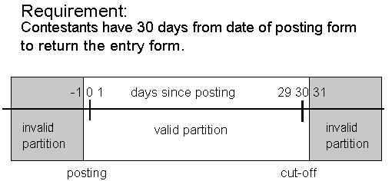
Equivalence partitioning example

Slide 11
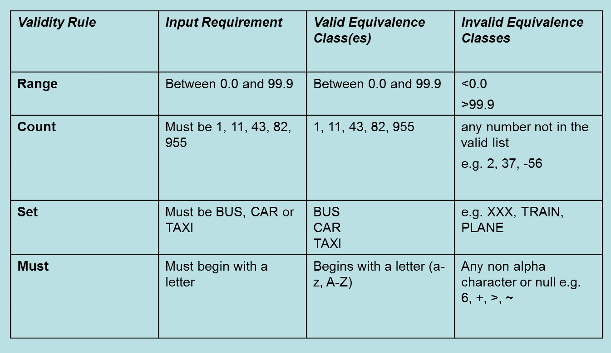
Identifying equivalence partitions

Slide 12
Identifying the partitions for ranges
Requirement:
“…must be between 23 and 30”
Does between “include” the values 23 and 30?
Implies:
The range 23 to 30 is valid
Less than 23 and greater than 30 are invalid
But does this mean <=22?
Or does it mean <=22.9999999?
Need to consider the precision of the domain under consideration
e.g. In finance, precision could be very important.

Slide 13
Selecting tests from partitions
When you have identified the partitions, which values should you take?
E.g. in a partition of 1-1000, which value would you choose for a test?
It doesn’t matter!
To achieve EP coverage, all that is required is to select ANY value in the range
If we believe the software treats every value in a partition in the same way, the test values in that partition are equivalent, according to our definition.

Slide 14
Test Case Strategy
Once the set of equivalence classes has been identified, here is how to derive test cases:
Assign a unique identifier to each equivalence class.
Until all valid equivalence classes have been covered by at least one test case, write a new test case covering as many of the valid equivalence classes as possible.
Until all invalid equivalence classes have been covered, write a test case that covers one, and only one, of the uncovered invalid equivalence classes.
For each test case, annotate it with the equivalence class identifiers that it covers.

Slide 15
Valid and Invalid Classes: When in doubt...
If there is any reason to believe that elements in an equivalence class are not handled in an identical manner by the implementation software, split the equivalence class into further classes.

Slide 16
Equivalence Class Partitioning
Consider creating an equivalence partition that handles the default, empty, blank, null, zero, or none conditions.
Default: no value supplied, and some value is assumed to be used instead.
Empty: value exists, but has no contents.
e.g. Empty string ″″
Blank: value exists, and has content.
e.g. String containing a space character ″ ″
Null: value does not exist or is not allocated.
E.g. object that has not been created.
Zero: numeric value
None: when selecting from a list, make no selection.

Slide 17
Equivalence Classes Partitioning - Problems
Specification doesn't always define expected output for invalid test-cases.
Strongly typed languages eliminate the need for the consideration of some invalid inputs.
Brute-force of defining a test case for every combination of the inputs’ ECs.
Provides good coverage, but...
…impractical when number of inputs and associated classes is large

Slide 18
Boundary Value Analysis

Slide 19
Boundary value analysis
Experience shows more faults at boundaries of equivalence partitions where partitions are continuous
So test cases just above, just below and on the boundary tend to find faults
Don't forget test cases for output partitions: just above, on, just below boundaries.

Slide 20
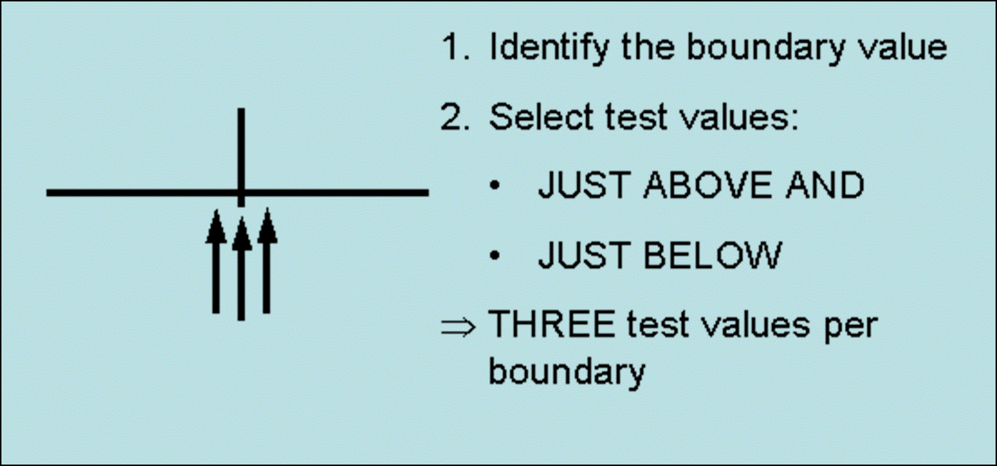
BS5925-2 boundary value analysis

Slide 21
Choosing the boundary can be subjective
Can be subjective e.g.
X < 100 (choose boundary = 100?)
X <= 99 (chose boundary = 99?)
The same requirement, but you could have different test values depending on the boundary:
99, 100, 101 or 98, 99, 100
Which is best?
Because testers can be “one out”, the standard suggests three boundary values (and not two) to guarantee you get the BEST two test cases.

Slide 22
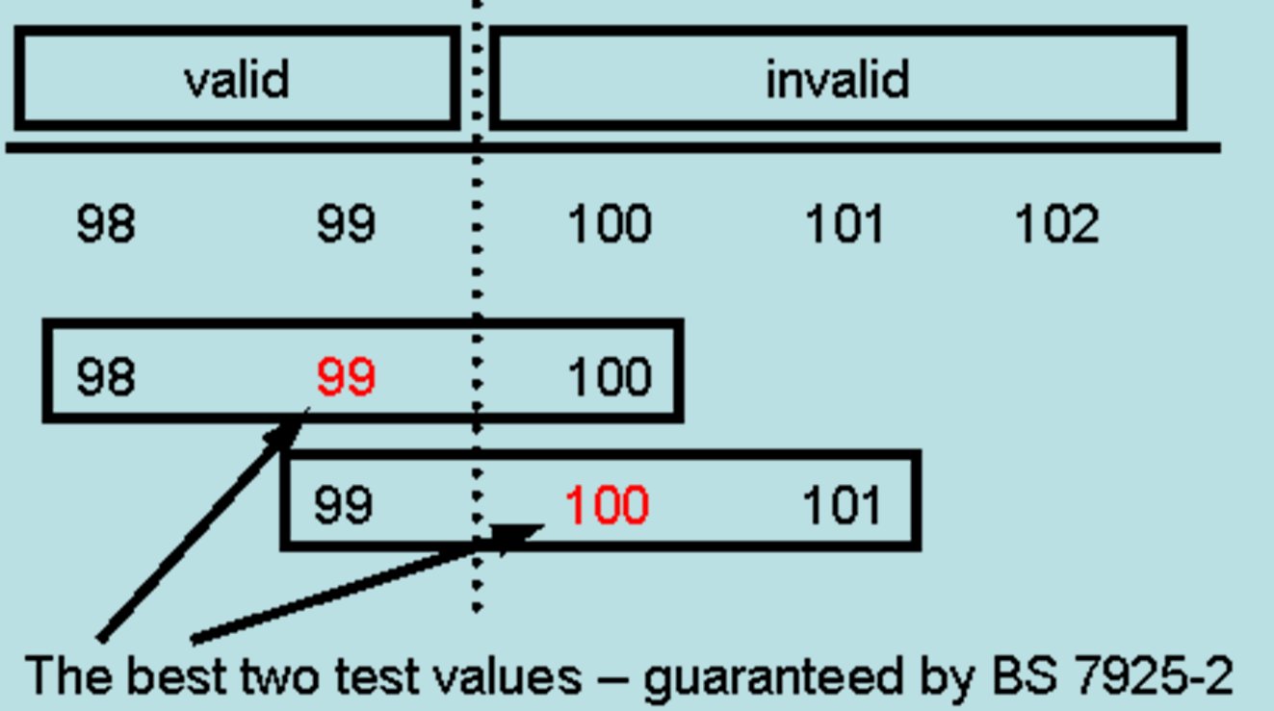
Choosing the boundary can be subjective 2

Slide 23
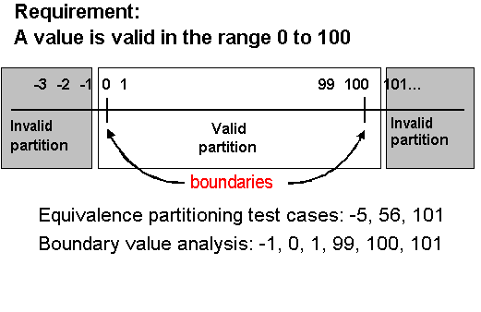
Boundary value analysis example

Slide 24
Boundary values subsumes equivalence partitions for ranges
BV subsumes EP where the partitions are ranges of values
If you have covered all boundary values you automatically get EP coverage
You might have chosen different EP values, but since all values in a partition ARE equivalent any test value – even extreme ones - will do it.

Slide 25
Questions

